Slide 1

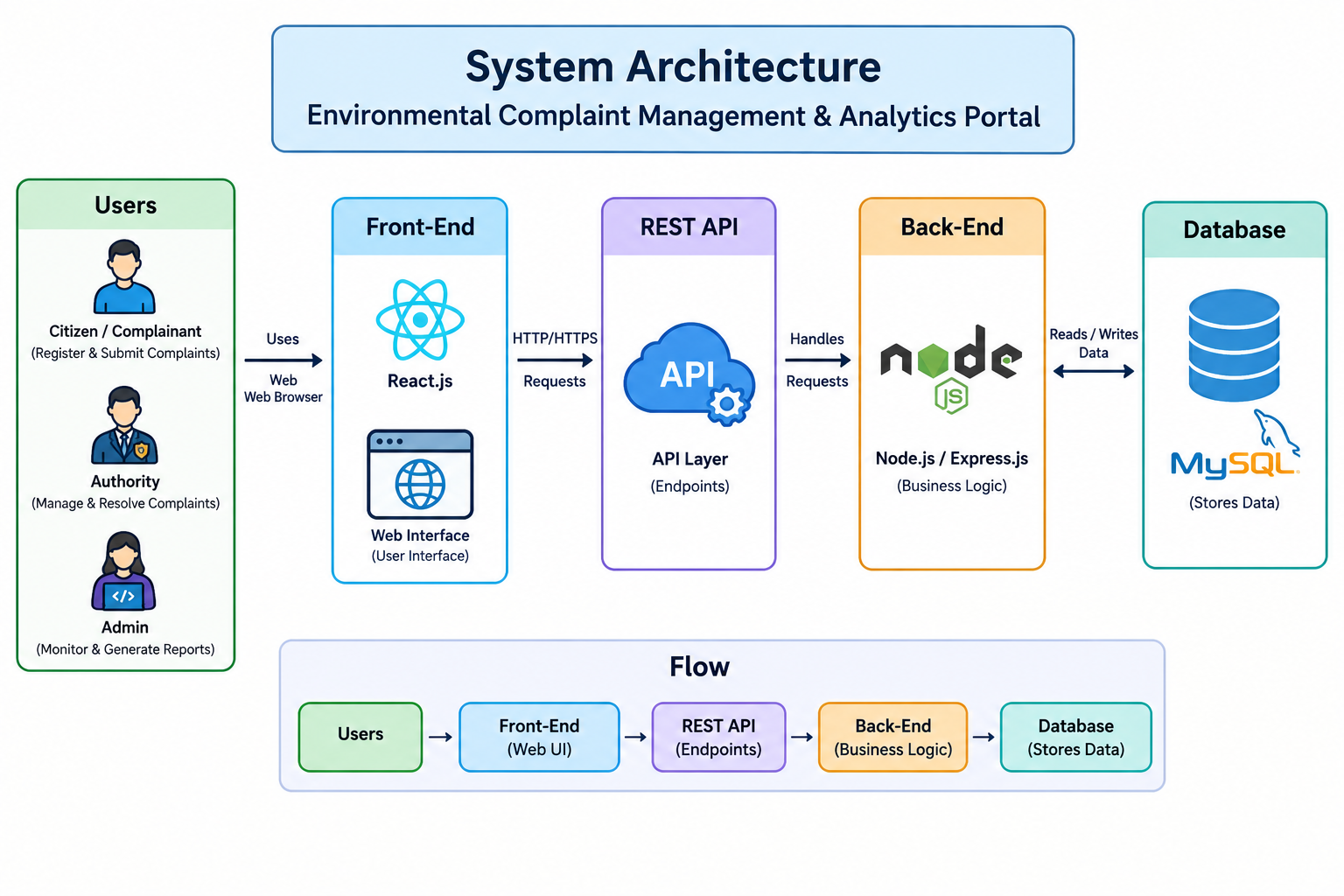
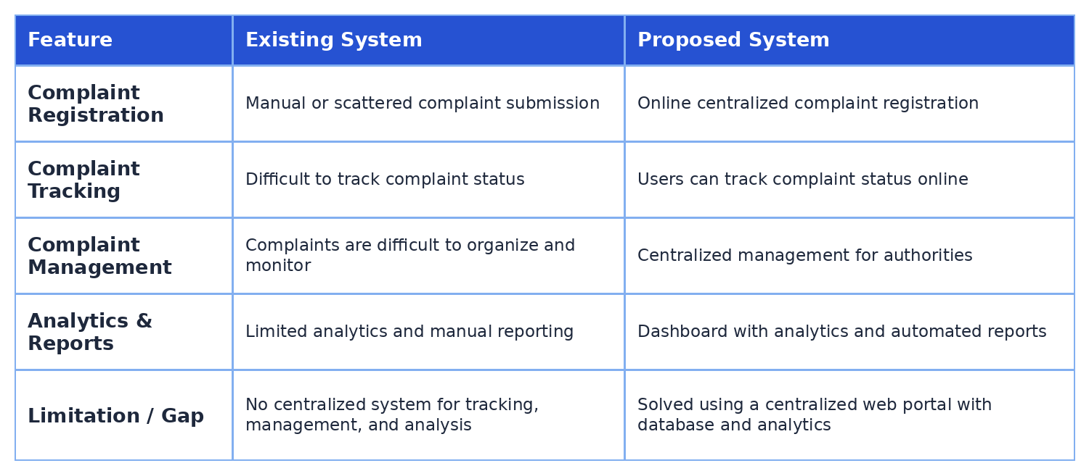
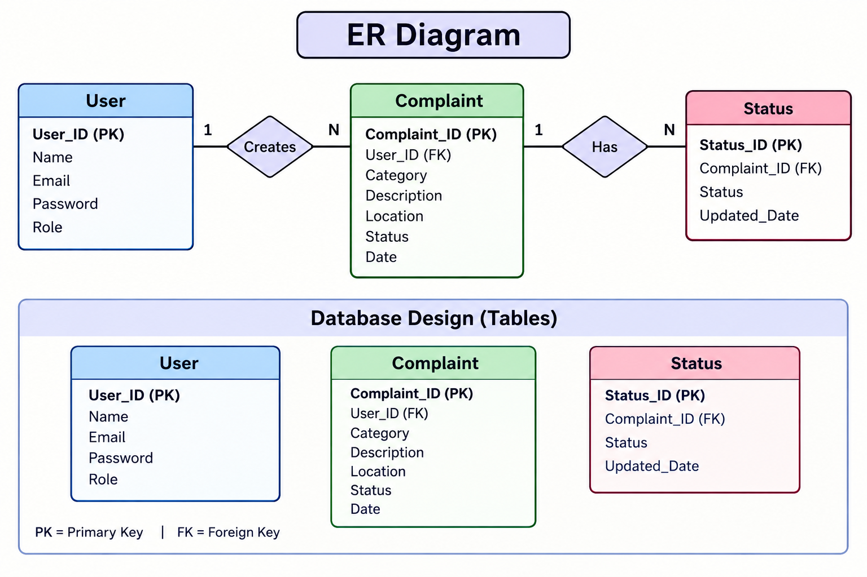
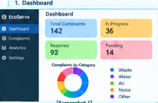
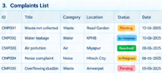

KLH Logo
Complaint management & analytics portal for environmental services
Team ID: [ 16 ] | Section: [S8] | Members: [Y .Sathwika – 2520030007], [M .Akhila – 2520030511], [Charan Sai – 2520030321] | Guide: [Dr. Spandana]
Database Systems Engineering and Distributed Backend Development (25CS1302E) | KLH Bachupally Campus, CSE | PBL 2026-27
Abstract
Tools & Technologies
The Complaint Management & Analytics Portal for Environmental Services is designed to provide a centralized platform for citizens to register environmental complaints and for authorities to manage, track, and analyze them efficiently.
Front-End: [React / HTML-CSS-JS]
Back-End: [Node.js / Spring Boot / ] + REST APIs
Database: [MySQL / MongoDB]
Tools: [Git & GitHub, Postman, VS Code]
Problem Statement & Objectives
Problem Statement
Existing environmental complaint systems are often scattered and difficult to manage.
Objectives
To develop a centralized portal for submitting and managing environmental complaints.
To generate analytics and reports to identify complaint trends and support better decision-making.
System Architecture
Existing vs Proposed System
ER Diagram & Database Design
Feasibility Study
Technical Feasibility: Uses available technologies and tools.
Economic Feasibility: Low development and maintenance cost.
Operational Feasibility: Easy for users and authorities to operate.
Schedule Feasibility: Can be completed within the project timeline.
Scalability: Can be expanded to handle more users and complaints.
Implementation Screenshots
Results & Testing
Conclusion
Future Scope
Successfully developed the Environmental Complaint Management & Analytics Portal. .
Complaint status can be tracked and updated.
The proposed system provides a centralized platform for managing environmental complaints.
It makes complaint registration and tracking easier for users.
Mobile Application: Develop a mobile app for easier complaint registration and tracking.
AI-Based Analysis: Use AI to categorize complaints and identify common environmental issues.
References: [1] [Author, Title, Year] [2] [Website / Documentation link] [3] [Paper / Book]
QR: GitHub

